Slide 1
Dr. Yifeng Zhu Electrical and Computer Engineering University of Maine
Embedded Systems with ARM Cortex-M Microcontrollers in Assembly Language and C
Chapter 2
Data Representation
Spring 2020

Slide 2
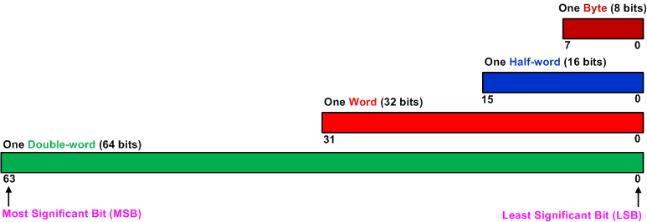
Bit, Byte, Half-word, Word, Double-Word

Slide 3
Binary, Octal, Decimal and Hex
Decimal | Binary | Octal | Hex
0 | 0000 | 00 | 0x0
1 | 0001 | 01 | 0x1
2 | 0010 | 02 | 0x2
3 | 0011 | 03 | 0x3
4 | 0100 | 04 | 0x4
5 | 0101 | 05 | 0x5
6 | 0110 | 06 | 0x6
7 | 0111 | 07 | 0x7
8 | 1000 | 010 | 0x8
9 | 1001 | 011 | 0x9
10 | 1010 | 012 | 0xA
11 | 1011 | 013 | 0xB
12 | 1100 | 014 | 0xC
13 | 1101 | 015 | 0xD
14 | 1110 | 016 | 0xE
15 | 1111 | 017 | 0xF

Slide 4
Magic 32-bit Numbers
Used as a special pattern for debug
Used as a special pattern of memory values during allocation and de-allocation
0xDEADBEEF | Dead Beef
0xBADDCAFE | Bad Cafe
0xFEE1DEAD | Feel Dead
0x8BADF00D | Ate Bad Food
0xBAADF00D | Bad Food
0xDEADC0DE | Dead Code
0xFACEB00C | Facebook
0xDEADD00D | Dead Dude

Slide 5
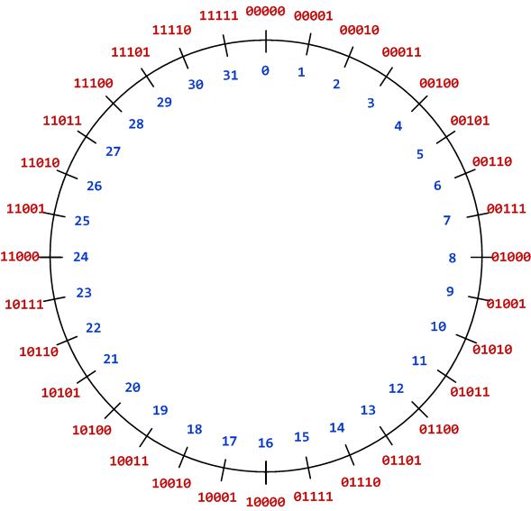
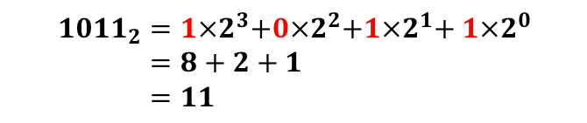
Unsigned Integers
Convert from Binary to Decimal:
$${1011}_{2}=1{×2}^{3}+0{×2}^{2}+1{×2}^{1}+ 1{×2}^{0} \\ =8+2+1 \\ =11$$
Five-bit binary code

Slide 6
Range of Unsigned Integers
Storage Size | Range | Powers of 2
Unsigned Byte | 0 to 255 | 0 to 2⁸-1
Unsigned Halfword | 0 to 65,535 | 0 to 2¹⁶-1
Unsigned Word | 0 to 4,294,967,295 | 0 to 2³²-1
Unsigned Double-word | 0 to 18,446,744,073,709,551,615 | 0 to 2⁶⁴-1

Slide 7
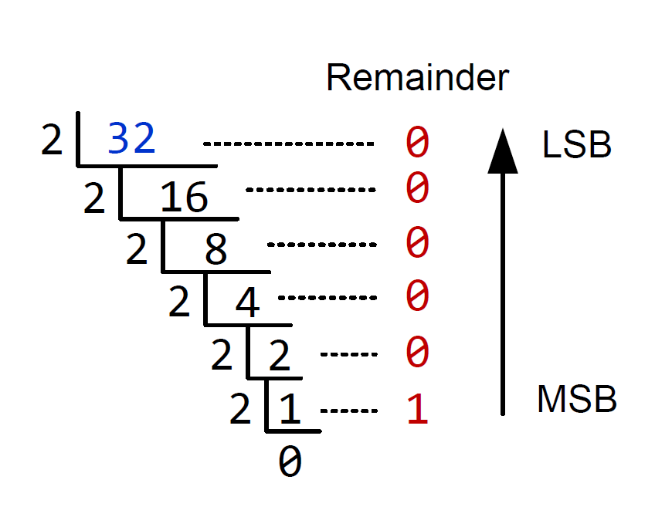
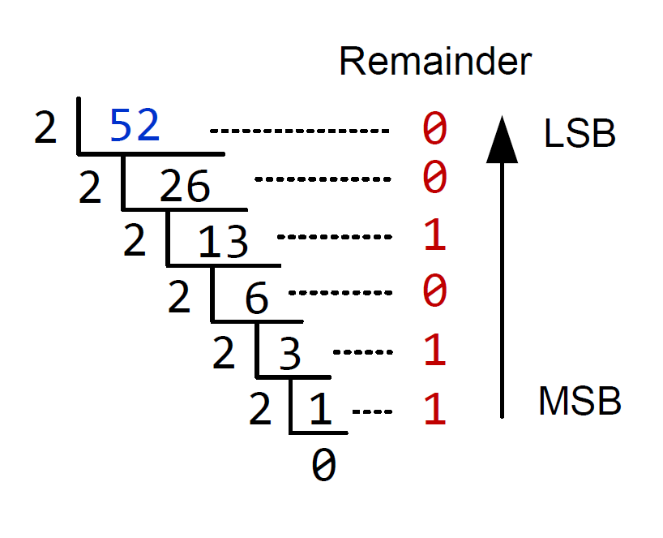
Unsigned Integers
Convert Decimal to Binary
Example 1
Example 2
52₁₀ = 110100₂
32₁₀ = 100000₂

Slide 8
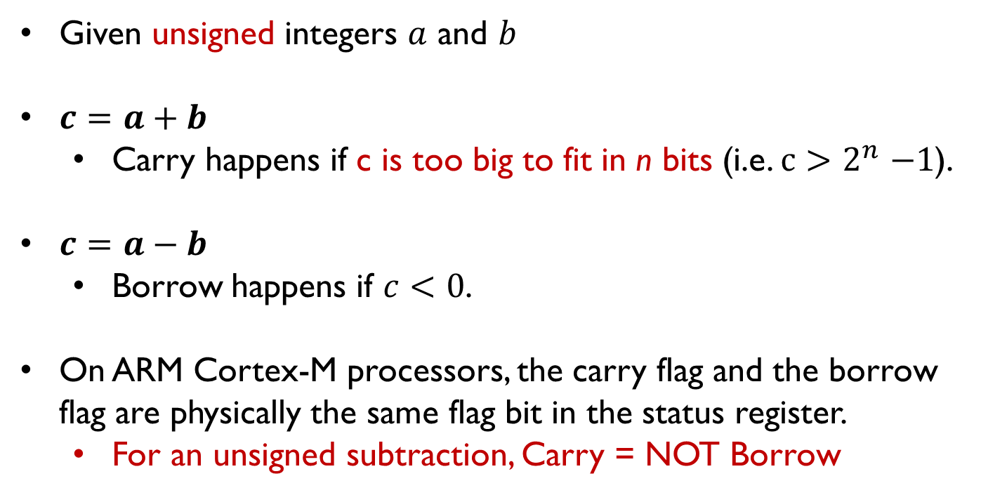
Carry/borrow flag bit for unsigned numbers
Given unsigned integers $a$ and $b$
$c=a+b$
Carry happens if c is too big to fit in n bits (i.e. $c{>2}^{n}−1$).
$c=a−b$
Borrow happens if $c<0$.
On ARM Cortex-M processors, the carry flag and the borrow flag are physically the same flag bit in the status register.
For an unsigned subtraction, Carry = NOT Borrow

Slide 9
Carry/borrow flag bit for unsigned numbers
If the traverse crosses the boundary between 0 and $2^{n}−1$, the carry flag is set on addition and is cleared on subtraction.
Carry flag = 1, indicating carry has occurred on unsigned addition.
Carry flag is 1 because the result crosses the boundary between 31 and 0.
A carry occurs when adding 28 and 6
Notes:
For unsigned numbers, the carry flag is set when adding two numbers and the result is larger than the maximum that can represented. For subtraction, the borrow bit is set when the result is positive, representing no borrowing occurs. The borrow bit is cleared when the result is negative. On the ARM processor, the carry bit and borrow bit are the same flag bit in the status register.

Slide 10
Carry/borrow flag bit for unsigned numbers
If the traverse crosses the boundary between 0 and $2^{n}−1$, the carry flag is set on addition and is cleared on subtraction.
Carry flag = 0, indicating borrow has occurred on unsigned subtraction.
For subtraction, carry = NOT borrow.
A borrow occurs when subtracting 5 from 3.
Notes:
For unsigned numbers, the carry flag is set when adding two numbers and the result is larger than the maximum that can represented. For subtraction, the borrow bit is set when the result is positive, representing no borrowing occurs. The borrow bit is cleared when the result is negative. On the ARM processor, the carry bit and borrow bit are the same flag bit in the status register.

Slide 11

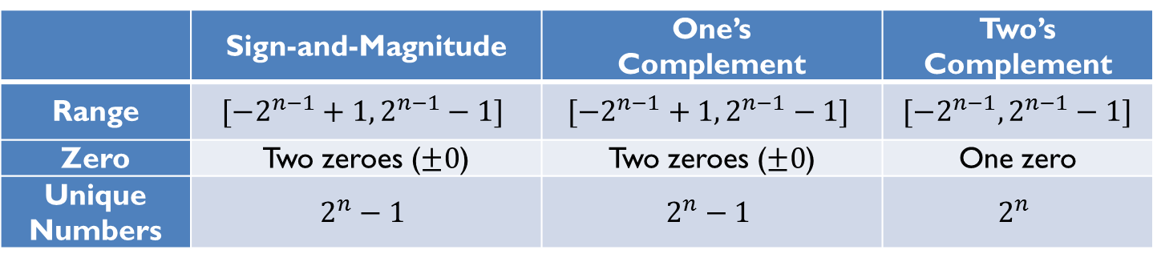
Signed Integer Representation
Three ways to represent signed binary integers:
Signed magnitude
$value={(−1)}^{sign}×Magnitude$
One’s complement ($\tilde{α}$)
$α+\tilde{α}=2^{n}−1$
Two’s complement ($\overline{α}$)
$α+\overline{α}=2^{n}$
 | Sign-and-Magnitude | One’s Complement | Two’s Complement
Range | $$[−2^{n−1}+1, 2^{n−1}−1]$$ | $$[−2^{n−1}+1, 2^{n−1}−1]$$ | $$[−2^{n−1}, 2^{n−1}−1]$$
Zero | Two zeroes ($±0$) | Two zeroes ($±0$) | One zero
Unique Numbers | $$2^{n}−1$$ | $$2^{n}−1$$ | $$2^{n}$$

Slide 12
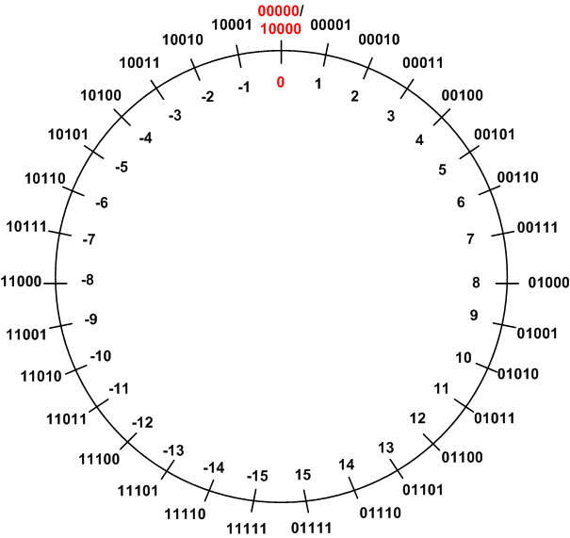
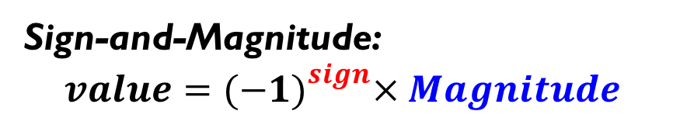
Signed Integers Method 1: Signed Magnitude
Sign-and-Magnitude:
$$value={(−1)}^{sign}×Magnitude$$
The most significant bit is the sign.
The rest bits are magnitude.
Example: in a 5-bit system
+7₁₀ = 00111₂
-7₁₀ = 10111₂
Two ways to represent zero
+0₁₀ = 00000₂
-0₁₀ = 10000₂
Not used in modern systems
Hardware complexity
Two zeros

Slide 13
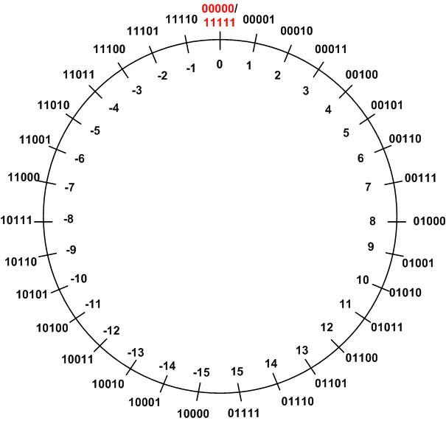

Signed Integers Method 2: One’s Complement
One’s Complement ($\tilde{α}$):
$$α+\tilde{α}=2^{n}−1$$
The one's complement representation of a negative binary number is the bitwise NOT of its positive counterpart.
Example: in a 5-bit system
+7₁₀ = 00111₂
-7₁₀ = 11000₂
+7₁₀ + (-7₁₀) = 00111₂ + 11000₂
= 11111₂
= 2⁵ - 1

Slide 14
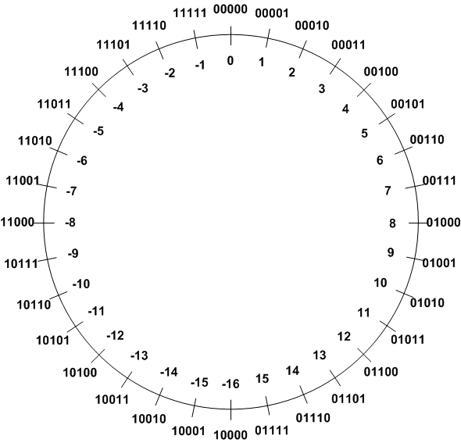
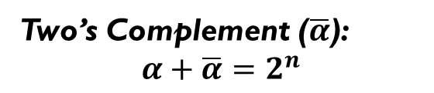
Signed Integers Method 3: Two’s Complement (TC)
Two’s Complement ($\overline{α}$):
$$α+\overline{α}=2^{n}$$
TC of a negative number can be obtained by the bitwise NOT of its positive counterpart plus one.
Example 1: TC(3)
 | Binary | Decimal
Original number | 0b00011 | 3
Step 1: Invert every bit | 0b11100
Step 2: Add 1 | + 0b00001
Two’s complement | 0b11101 | -3

Slide 15
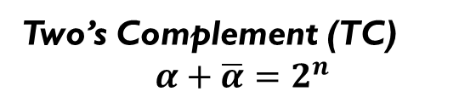
Signed Integers Method 3: Two’s Complement (TC)
Two’s Complement (TC)
$$α+\overline{α}=2^{n}$$
TC of a negative number can be obtained by the bitwise NOT of its positive counterpart plus one.
Example 2: TC(-3)
 | Binary | Decimal
Original number | 0b11101 | -3
Step 1: Invert every bit | 0b00010
Step 2: Add 1 | + 0b00001
Two’s complement | 0b00011 | 3

Slide 16
Comparison
Signed magnitude representation
0 = positive
1 = negative
One’s complement representation
Negative = invert all bits of a positive
Two’s Complement representation
TC = invert all bits, then plus 1
Used in modern computers!

Slide 17
Range of Signed Integers (Two’s Complement)
Storage Size | Range | Powers of 2
Signed Byte | -128 to +127 | -2⁷ to 2⁷-1
Signed Halfword | -32,768 to +32,767 | -2¹⁵ to 2¹⁵-1
Signed Word | -2,147,483,648 to +2,147,483,647 | -2³¹ to 2³¹-1
Signed Double-word | -9,223,372,036,854,775,808 to +9,223,372,036,854,775,807 | -2⁶³ to 2⁶³-1

Slide 18
Overflow for Signed Add/Sub
When adding signed numbers represented in two’s complement, overflow occurs only in two scenarios:
adding two positive numbers but getting a non-positive result, or
adding two negative numbers but yielding a non-negative result.
Similarly, when subtracting signed numbers, overflow occurs in two scenarios:
subtracting a positive number from a negative number but getting a positive result, or
subtracting a negative number from a positive number but producing a negative result.
Overflow cannot occur when adding operands with different signs or when subtracting operands with the same signs.

Slide 19
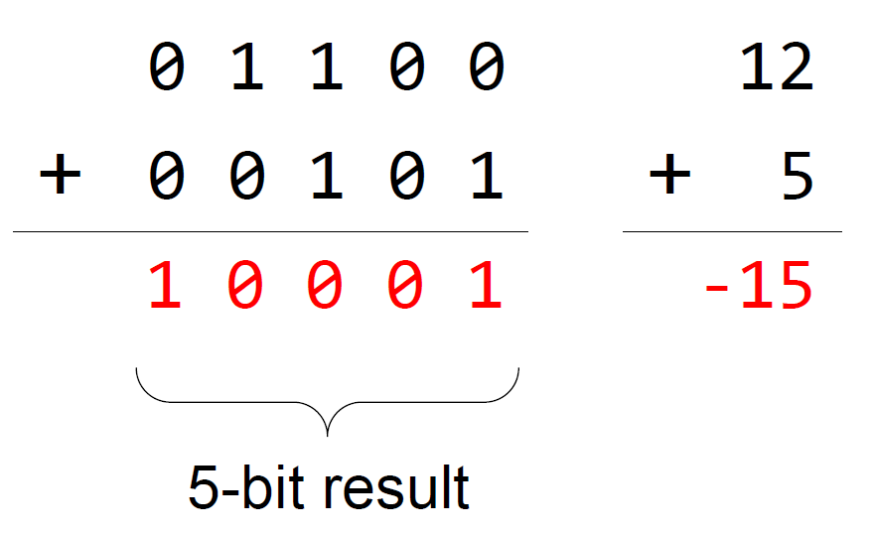
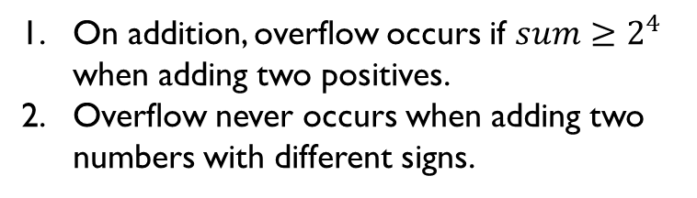
Overflow for Signed Add
On addition, overflow occurs if $sum≥2^{4}$ when adding two positives.
Overflow never occurs when adding two numbers with different signs.
Overflow occurs when adding two positive integers but getting a negative result.
Notes:
For signed numbers represented in two’s complement, an overflow occurs only in two scenarios:
Add two positive numbers and get a negative result
Add two negative numbers and get a positive result

Slide 20
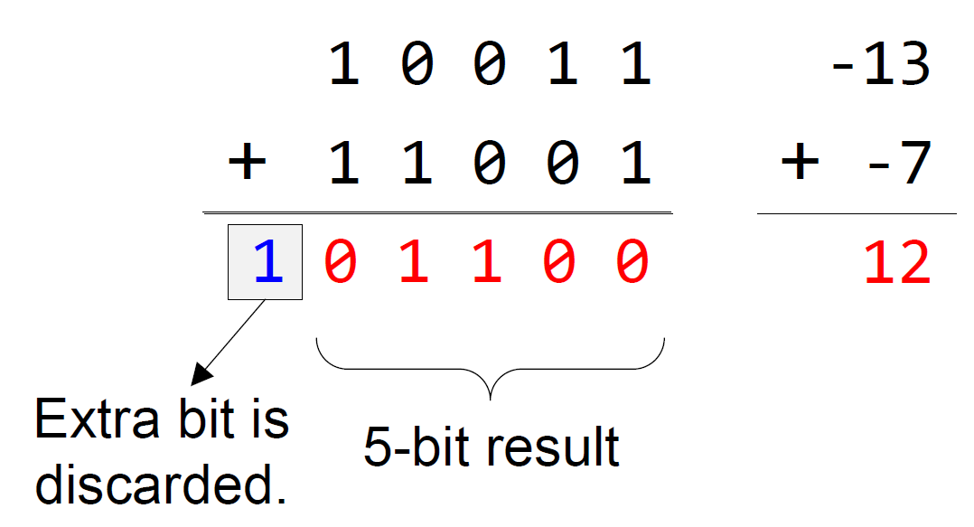
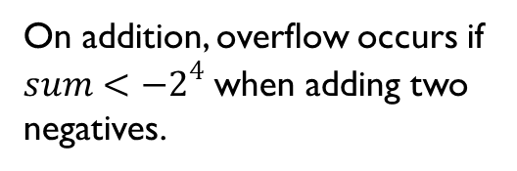
Overflow for Signed Add
On addition, overflow occurs if $sum<−2^{4}$ when adding two negatives.
Overflow occurs when adding two negative integers but getting a positive result.
Notes:
For signed numbers represented in two’s complement, an overflow occurs only in two scenarios:
Add two positive numbers and get a negative result
Add two negative numbers and get a positive result

Slide 21
Signed or Unsigned
a = 0b10000
b = 0b10000
c = a + b
Are a and b signed or unsigned numbers?
CPU does not know the answer at all.
Therefore the hardware sets up both the carry flag and the overflow flag.
It is software’s (programmers’/compilers’) responsibility to interpret the flags.

Slide 22
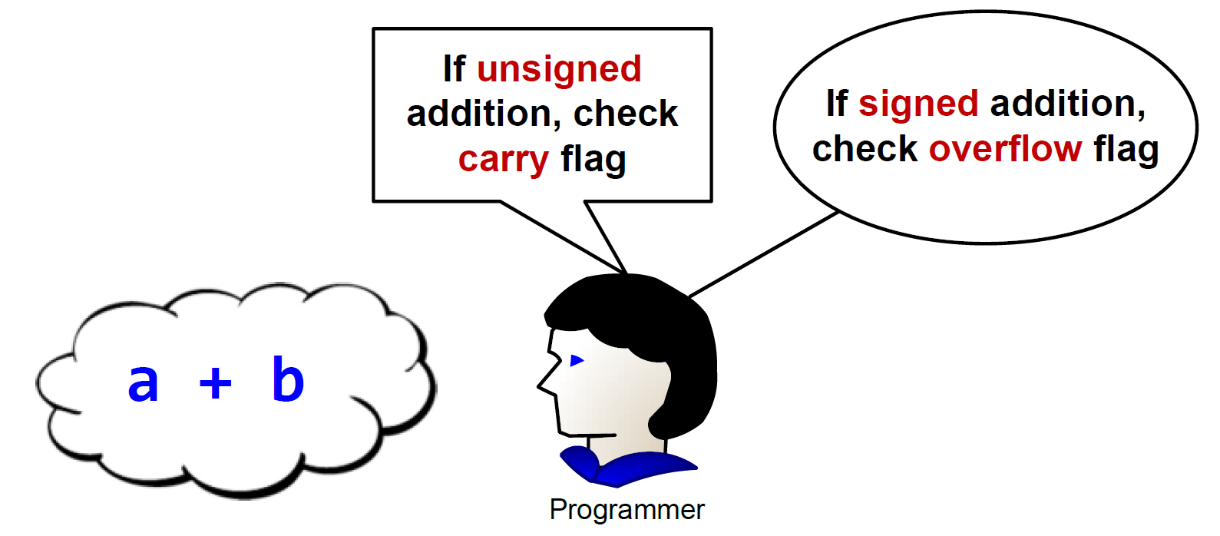
Signed or unsigned
Whether the carry flag or the overflow flag should be used depends on the programmer’s intention.
When programming in high-level languages such as C, the compiler automatically chooses to use the carry or overflow flag based on how this integer is declared in source code (“int” or “unsigned int”).

Slide 23
Signed or Unsigned
a = 0b10000
b = 0b10000
c = a + b
Are a and b signed or unsigned numbers?
uint a;
uint b;
…
c = a + b
…
Check the carry flag!
C Program

Slide 24
Signed or Unsigned
a = 0b10000
b = 0b10000
c = a + b
Are a and b signed or unsigned numbers?
int a;
int b;
…
c = a + b
…
Check the overflow flag!
C Program

Slide 25
Signed Integer Representation Method 3: Two’s Complement
Assume a four-bit system:
Expression | Result | Carry? | Overflow? | Correct Result?
0100 + 0010 | 0110
0100 + 0110 | 1010
1100 + 1110 | 1010
1100 + 1010 | 0110

Slide 26
Signed Integer Representation Method 3: Two’s Complement
Assume a four-bit system:
Expression | Result | Carry? | Overflow? | Correct Result?
0100 + 0010 | 0110 | No | No | Yes
0100 + 0110 | 1010 | No | Yes | No
1100 + 1110 | 1010 | Yes | No | Yes
1100 + 1010 | 0110 | Yes | Yes | No

Slide 27
Why use Two’s Complement
Two’s complement simplifies hardware
Operation | Are signed and unsigned operations the same?
Addition | Yes
Subtraction | Yes
Multiplication | Yes if the product is required to keep the same number of bits as operands
Division | No
Notes:
Why do we use two’s complement? {{Pause=0.5}} One of the advantages is that two’s complement can simplify the hardware implementation of arithmetic functions. If signed integers are represented in two’s complement, the hardware can ignore the sign of operands for addition or subtraction. If the product is required to keep the same number of bits as operands, the multiplication hardware can also ignore the sign of operands. This property of two’s complement simplifies the hardware design for addition, subtraction and multiplication. Note that this property does not hold true for division.

Slide 28
Adding two signed integers: (-9) + 6
-9
+
6
9
flip
+1
-9
1 | 0 | 1 | 1 | 1
0 | 0 | 1 | 1 | 0
01001
10110
10111
23
6
Two’s Complement
Simple Hardware Adder
29
flip
+1
3
1 | 1 | 1 | 0 | 1
00010
00011
Two’s Complement Counterpart
-3
Notes:
{{Pause=1}} We will use a very simple example to show that, the hardware adder for adding unsigned numbers, also works correctly for adding signed numbers. {{Pause=0.5}}
Suppose we are adding negative nine and six. {{Pause=0.5}} These two signed numbers are represented in two’s complement in computers. {{Pause=0.5}}
Specifically, we can obtain the two’s complement representation of negative nine by flipping all bits and adding one. {{Pause=0.5}} The two’s complement of a positive number is itself. {{Pause=0.5}}
Let’s see what will happen if the hardware treats these two inputs as unsigned numbers. If these binary bits represent unsigned numbers, they are 23 and 6, respectively. Therefore, the hardware adds 23 and 6, and produces 29, in decimal, {{Pause=0.3}} or one, one, one, zero, one, in binary. {{Pause=0.5}}
If the output represents a signed integer in two’s complement, it actually represents negative 3. This can be proved by inverting all the bits and adding one. The result, negative three, is exactly the sum of the original signed inputs. {{Pause=0.5}}
This example shows that, without any modification, the hardware adder designed for adding unsigned numbers, works correctly for adding signed numbers.

Slide 29
Subtracting two signed integers: (-9) - 6
-9
-
6
9
flip
+1
-9
1 | 0 | 1 | 1 | 1
0 | 0 | 1 | 1 | 0
01001
10110
10111
23
6
Two’s Complement
Simple Hardware Subtractor
17
15
flip
+1
-15
1 | 0 | 0 | 0 | 1
01111
10000
10001
-15
Notes:
{{Pause=1}} Similarly, the same subtraction hardware works correctly for both signed and unsigned subtraction, even though the sign of input operands is not examined. {{Pause=0.3}} This example subtracts 6 from negative 9. The hardware ignores the sign of the inputs, and subtracts 6 from 23. The result is 17, in decimal, {{Pause=0.3}} or one, zero, zero, zero, one, in binary. If the result represents a signed integer in two’s complement, then the result is negative 15. This is exactly the result of subtracting the original signed integers.

Slide 30
Two’s Complement Simplifies Hardware Implementation
In two’s complement, the same hardware works correctly for both signed and unsigned addition/subtraction.
If the product is required to keep the same number of bits as operands, unsigned multiplication hardware works correctly for signed numbers.
However, this is not true for division.

Slide 31
Condition Codes
Bit | Name | Meaning after add or sub
N | negative | result is negative
Z | zero | result is zero
V | overflow | signed arithmetic out of range
C | carry | signed arithmetic out of range
C is set upon an unsigned addition if the answer is wrong
C is cleared upon an unsigned subtract if the answer is wrong
V is set upon a signed addition or subtraction if the answer is wrong
Why do we care about these bits?
31

Slide 32

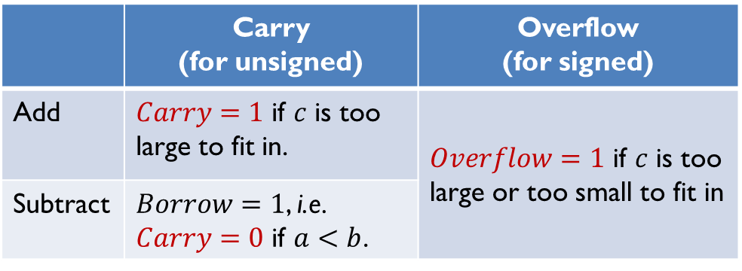
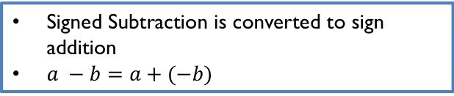
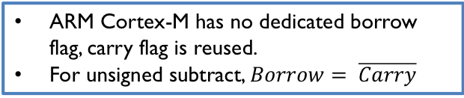
Carry and Overflow
$$c=a±b$$
 | Carry (for unsigned) | Overflow (for signed)
Add | $Carry=1$ if $c$ is too large to fit in. | $Overflow=1$ if $c$ is too large or too small to fit in
Subtract | $Borrow=1$, i.e. $Carry=0$ if $a<b$.
ARM Cortex-M has no dedicated borrow flag, carry flag is reused.
For unsigned subtract, $Borrow= \overline{Carry}$
Signed Subtraction is converted to sign addition
$a −b=a+(−b)$

Slide 33
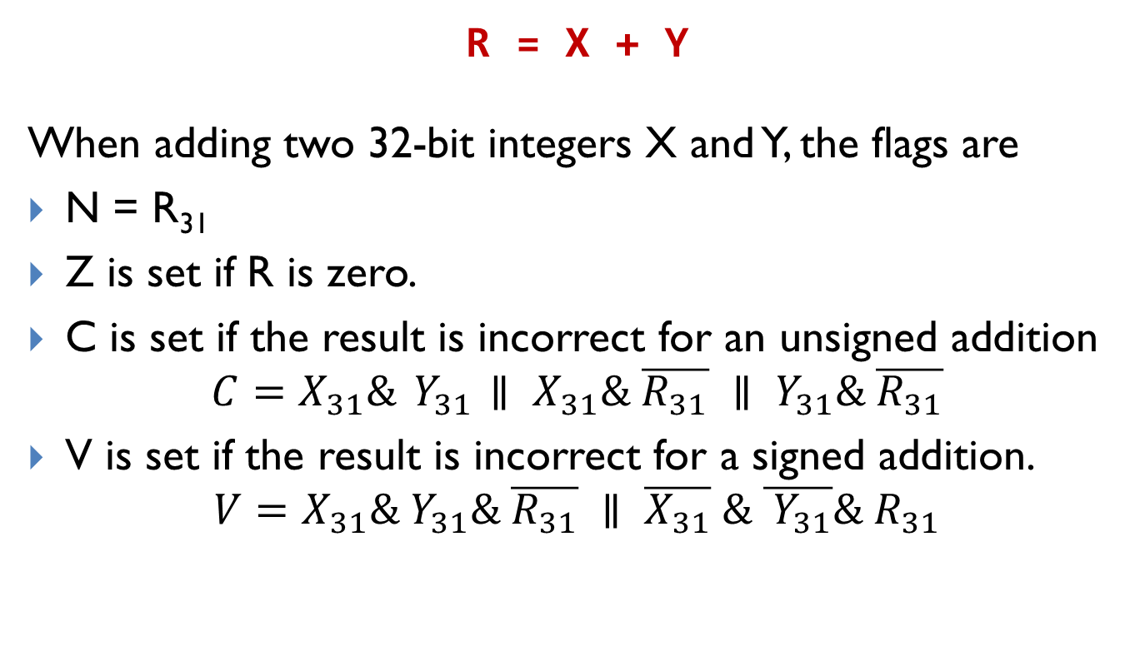
Formal Representation for Addition
R = X + Y
When adding two 32-bit integers X and Y, the flags are
N = R₃₁
Z is set if R is zero.
C is set if the result is incorrect for an unsigned addition
$$C=X_{31}\&{ Y}_{31} ∥ X_{31}\& \overline{R_{31}} ∥ Y_{31}\& \overline{R_{31}}$$
V is set if the result is incorrect for a signed addition.
$$V=X_{31}\&{ Y}_{31}\& \overline{R_{31}} ∥ \overline{X_{31}} \& \overline{{ Y}_{31}}\& R_{31}$$

Slide 34
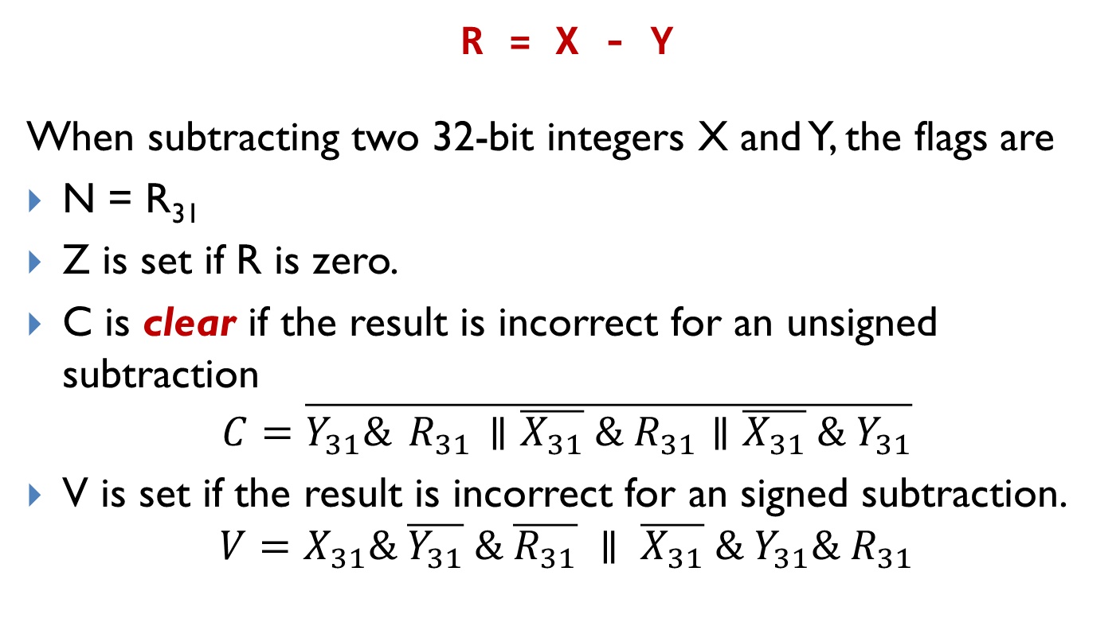
Formal Representation for Subtraction
R = X - Y
When subtracting two 32-bit integers X and Y, the flags are
N = R₃₁
Z is set if R is zero.
C is clear if the result is incorrect for an unsigned subtraction
$$C=\overline{Y_{31}\&{ R}_{31} ∥\overline{X_{31}} \& R_{31}∥\overline{X_{31}} \&{ Y}_{31}}$$
V is set if the result is incorrect for an signed subtraction.
$$V=X_{31}\& \overline{Y_{31}} \& \overline{R_{31}} ∥ \overline{X_{31}} \& Y_{31}\& R_{31}$$

Slide 35
Characters
Dec | Hex | Char | Dec | Hex | Char | Dec | Hex | Char | Dec | Hex | Char
0 | 00 | NUL | 32 | 20 | SP | 64 | 40 | @ | 96 | 60 | ‘
1 | 01 | SOH | 33 | 21 | ! | 65 | 41 | A | 97 | 61 | a
2 | 02 | STX | 34 | 22 | " | 66 | 42 | B | 98 | 62 | b
3 | 03 | ETX | 35 | 23 | # | 67 | 43 | C | 99 | 63 | c
4 | 04 | EOT | 36 | 24 | $ | 68 | 44 | D | 100 | 64 | d
5 | 05 | ENQ | 37 | 25 | % | 69 | 45 | E | 101 | 65 | e
6 | 06 | ACK | 38 | 26 | & | 70 | 46 | F | 102 | 66 | f
7 | 07 | BEL | 39 | 27 | ’ | 71 | 47 | G | 103 | 67 | g
8 | 08 | BS | 40 | 28 | ( | 72 | 48 | H | 104 | 68 | h
9 | 09 | HT | 41 | 29 | ) | 73 | 49 | I | 105 | 69 | i
10 | 0A | LF | 42 | 2A | * | 74 | 4A | J | 106 | 6A | j
11 | 0B | VT | 43 | 2B | + | 75 | 4B | K | 107 | 6B | k
12 | 0C | FF | 44 | 2C | , | 76 | 4C | L | 108 | 6C | l
13 | 0D | CR | 45 | 2D | - | 77 | 4D | M | 109 | 6D | m
14 | 0E | SO | 46 | 2E | . | 78 | 4E | N | 110 | 6E | n
15 | 0F | SI | 47 | 2F | / | 79 | 4F | O | 111 | 6F | o
16 | 10 | DLE | 48 | 30 | 0 | 80 | 50 | P | 112 | 70 | p
17 | 11 | DC1 | 49 | 31 | 1 | 81 | 51 | Q | 113 | 71 | q
18 | 12 | DC2 | 50 | 32 | 2 | 82 | 52 | R | 114 | 72 | r
19 | 13 | DC3 | 51 | 33 | 3 | 83 | 53 | S | 115 | 73 | s
20 | 14 | DC4 | 52 | 34 | 4 | 84 | 54 | T | 116 | 74 | t
21 | 15 | NAK | 53 | 35 | 5 | 85 | 55 | U | 117 | 75 | u
22 | 16 | SYN | 54 | 36 | 6 | 86 | 56 | V | 118 | 76 | v
23 | 17 | ETB | 55 | 37 | 7 | 87 | 57 | W | 119 | 77 | w
24 | 18 | CAN | 56 | 38 | 8 | 88 | 58 | X | 120 | 78 | x
25 | 19 | EM | 57 | 39 | 9 | 89 | 59 | Y | 121 | 79 | y
26 | 1A | SUB | 58 | 3A | : | 90 | 5A | Z | 122 | 7A | z
27 | 1B | ESC | 59 | 3B | ; | 91 | 5B | [ | 123 | 7B | {
28 | 1C | FS | 60 | 3C | < | 92 | 5C | \ | 124 | 7C | |
29 | 1D | GS | 61 | 3D | = | 93 | 5D | ] | 125 | 7D | }
30 | 1E | RS | 62 | 3E | > | 94 | 5E | ^ | 126 | 7E | ~
31 | 1F | US | 63 | 3F | ? | 95 | 5F | _ | 127 | 7F | DEL
American
Standard
Code for
Information
Interchange
Standard ASCII
0 - 127
Extended ASCII
0 - 255
ANSI
0 - 255
Unicode
0 - 65535
Standard ASCII: Encoding 128 characters

Slide 36
Null-terminated String
char str[13] = “ARM Assembly”; // The length has to be at least // 13 even though it has 12 // letters. The NULL terminator // should be included. or simply char str[] = “ARM Assembly”;
Memory Address | Memory Content | Letter
str + 12 → | 0x00 | \0
str + 11 → | 0x79 | y
str + 10 → | 0x6C | l
str + 9 → | 0x62 | b
str + 8 → | 0x6D | m
str + 7 → | 0x65 | e
str + 6 → | 0x73 | s
str + 5 → | 0x73 | s
str + 4 → | 0x41 | A
str + 3 → | 0x20 | space
str + 2 → | 0x4D | M
str + 1 → | 0x52 | R
str → | 0x41 | A

Slide 37
String Comparison
Strings are compared based on their ASCII values
“j” < “jar” < “jargon” < “jargonize”
“CAT” < “Cat” < “DOG” < “Dog” < “cat” < “dog”
“12” < “123” < “2”< “AB” < “Ab” < “ab” < “abc”

Slide 38
String Length
Stings are terminated with a null character (NUL, ASCII value 0x00)
Pointer dereference operator *
int strlen (char *pStr){ int i = 0; // loop until *pStr is NULL while( *pStr ) { i++; pStr++; } return i; }
Array subscript operator [ ]
int strlen (char *pStr){ int i = 0; // loop until pStr[i] is NULL while( pStr[i] ) i++; return i; }

Slide 39
Convert to Upper Case
A | B | C | D | E | F | G | H | I | J | K | L | M | N | O | P | Q | R | S | T | U | V | W | X | Y | Z
41 | 42 | 43 | 44 | 45 | 46 | 47 | 48 | 49 | 4A | 4B | 4C | 4D | 4E | 4F | 50 | 51 | 52 | 53 | 54 | 55 | 56 | 57 | 58 | 59 | 5A
a | b | c | d | e | f | g | h | i | j | k | l | m | n | o | p | q | r | s | t | u | v | w | x | y | z
61 | 62 | 63 | 64 | 65 | 66 | 67 | 68 | 69 | 6A | 6B | 6C | 6D | 6E | 6F | 70 | 71 | 72 | 73 | 74 | 75 | 76 | 77 | 78 | 79 | 7A
‘a’ – ‘A’ = 0x61 – 0x41 = 0x20 = 32
Pointer dereference operator *
void toUpper(char *pStr){ char *p; for(*p = pStr; *p; ++p){ if(*p >= ’a’ && *p <= ’z’) *p -= ‘a’ – ‘A’; //or: *p -= 32; } }
Array subscript operator [ ]
void toUpper(char *pStr){ int i; char c = pStr[0]; for(i = 0; c; i++, c = pStr[i];) { if(c >= ’a’ && c <= ’z’) pStr[i] -= ‘a’ – ‘A’; // or: pStr[i] -= 32; } }

